Slide 1
UML Diagrams
Paint

Slide 2
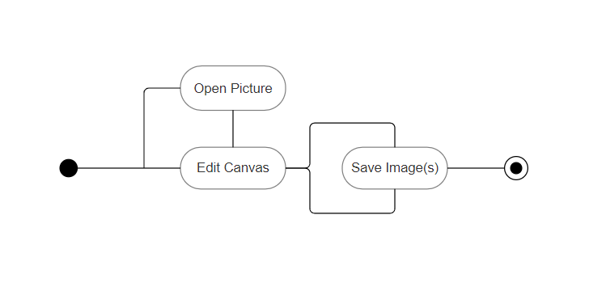
Basic Paint Usage

Slide 3
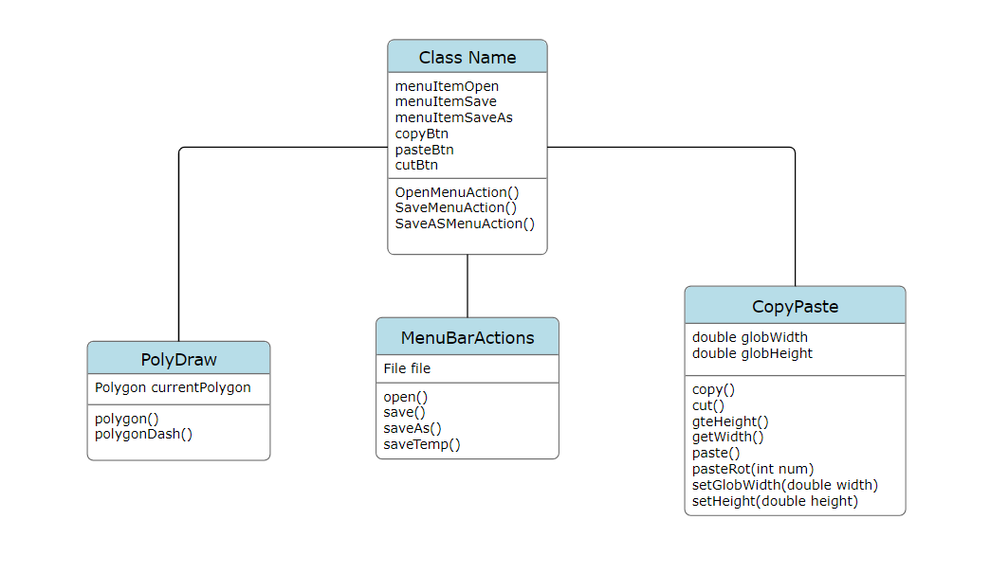
Basic Class Diagram

Slide 4
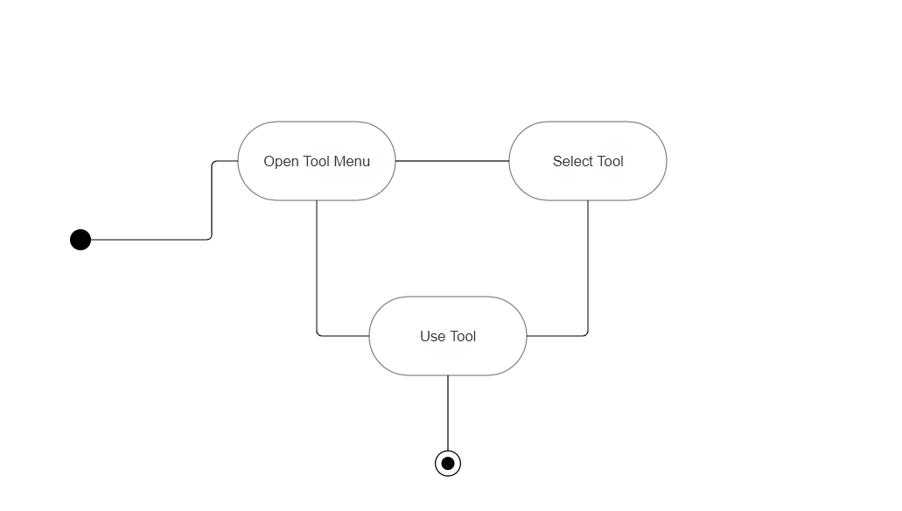
Selecting Tools Diagram

Slide 5
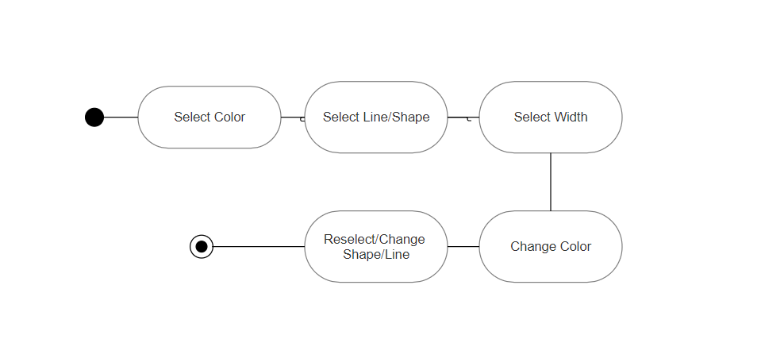
Color/Line Selection Diagram

